Slide 1
Agile Introduction

Slide 2
Agile Basics

Slide 3
What Is Agile
Agile --readiness for motion, activity, dexterity in motion
Agility
The ability to both create and respond to change in order to profit in a turbulent business environment
Companies need to determine the amount of agility they need to be competitive
Chaordic
Exhibiting properties of both chaos and order
The blend of chaos and order inherent in the external environment and in people themselves, argues against the prevailing wisdom about predictability and planning
Things get done because people adapt, not because they slavishly follow processes

Slide 4
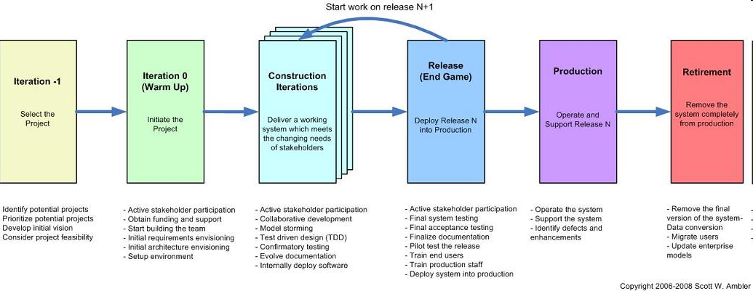
Agile Development – What does it mean?
Agile is a set of practices, values, and principles for software product development.
In software product development, we think about “methodologies,” “activities,” “interactions,” “results, work products or artifacts;” we think about “processes” that we use to organize the work:
documents
meetings and reviews
diagrams and models
coding and user documentation standards
So will Agile Development define a new set of process activities? Not necessarily.
Notes:
The main tasks of software development are still the same in Agile development – but the flow of activities will look a lot different.

Slide 5

What is Agile? (Agile vs. Sequential Models or Frameworks)
Many of us are familiar with the Waterfall Model – it is a “framework” for the software development process
Waterfall Model talks about “development activities through time”
Waterfall Model talks about “teams of people”
Development activities | Teams
Divide the work into stages | A separate team of specialists for each stage
At each stage, the work is passed from one team to another | Some coordination is required for the handoff from team to team – using “documents”
At the end of all of the stages, you have a software product ready to ship | As each team finishes, they are assigned to a new product
Notes:
The main ideas of Waterfall:
Each of the development activities is a separate “stage” – with a “gate” that they must pass at the end of the stage
We can think of team of specialists as working at its own station on a factory assembly line
Waterfall can be thought of as an “efficient” process because the work is structured in a way that allows each team to be reassigned to other projects when their part of the project is complete.
Unfortunately, this doesn’t always work so well. The communication between teams is usually imperfect and inefficient. It is a lot of work to create “complete” documentation at each stage of the process, and if the requirements or architecture teams have moved on to other projects, the design/development and test teams might not be able to get their questions answered promptly.
If there are late requirements and architecture changes, the waterfall process has even more overhead costs – documents need to be updated, re-reviewed, and approved in order to conform to the overall process.

Slide 6

What is Agile? (continued)
The core ideas in Agile Development:
Adaptive
Iterative/incremental
People-oriented
Adaptive means that the teams and the process should be flexible in the presence of “rapid-fire change”.
Iterative and incremental means that Agile Development produces working products in stages – a growing set of “completed and working software”.
People-oriented means the team organization and processes will support good people, who are the most important ingredient to project success.
Notes:
The list of “core ideas” is from this paper -- Noura Abbas, Andrew M. Gravell, and Gary B. Wills, “Historical Roots of Agile Methods: Where Did “Agile Thinking” Come From?” Proceedings of XP 2008, pp. 94-103.
In theory, the Waterfall Model could be used in an Adaptive and People-oriented way. In practice, however, Waterfall projects are pretty rigid and bureaucratic.
(It is interesting that most manufacturing work has been moving away from the old-fashioned rigid assembly line techniques of the early twentieth century – because management has found that they can get better quality and productivity with cross-trained cross-functional teams. So why are “knowledge workers” (software professionals) are often managed in a more assembly-line style than factory workers?)

Slide 7
Iterative development
One way to organize agile development is using short iterations:
Each iteration
might be 4 weeks
iteration
planning
iteration
1
iteration
2
iteration
3
iteration
4
iteration
5
iteration
6
Today
Ship date
Internal prototype (demo 1)
Customer-viewable prototype (demo 2)
Customer-viewable prototype (demo 3)
Each iteration step:
has some analysis, some design, some coding, some integration and testing
executed by a cross-functional team
delivers some kind of internally or externally usable functionality – intermediate demos or deliveries are possible!
Question:
Could we do a “demo” every iteration?
Absolutely yes! The team gets practice at doing system integration
Notes:
Why iteration? It gives the development team a chance to change course several times during the course of development.
In this example, with six iterations of 4 weeks each, the team can take a breath and say “we are done with part of the system” six times during a 24-week period – and they should be able to demonstrate that they have implemented some real customer-visible functionality. Then the team can ask some most important questions:
“Are we building the right things?”
“Will the performance be adequate for the customer?”
“Can we find some tools, components, architecture changes, or development process changes that can improve the rest of the development work?”

Slide 8

Main characteristics of Agile Development
Agile Development as a “software development framework” says:
keep things small
deliver partially-completed software frequently
talk to the customer often
write more code than documentation
everyone on the team learns together
Every 4 weeks, produce a new shippable product
Work for the
current
iteration
Work for future
iterations
Notes:
Planning in Agile development:
The most detailed plans are for the current iteration
The work for future iterations can be adjusted after talking with the customers
No “big design document” – because the future work might change, depending on the customers’ priorities
In a good Agile project, the team “gets into a rhythm” – delivering a set of new features every cycle

Slide 9



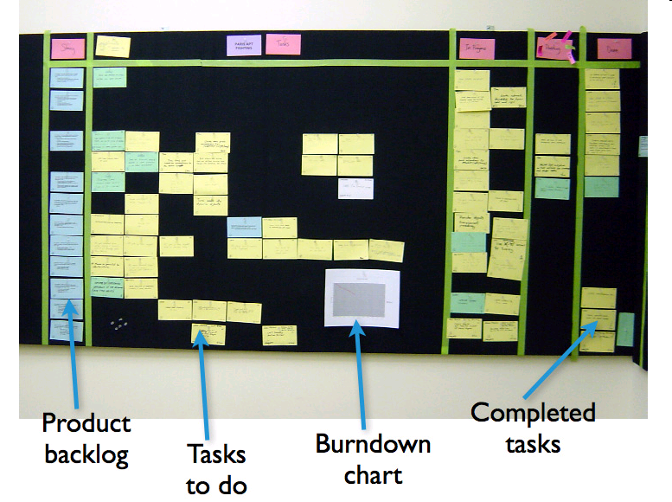
Agile Practices
There are many Agile practices:
short timeboxed iterations
continuous integration
daily unit testing
regular retrospectives
direct communication between developers and the customer or a customer surrogate
a single list of features and tasks
short-term estimation of development tasks
information radiators
refactoring
Will you use every Agile practice? Maybe not…. they are not all required.
What is required? Agile values…
Check in changes
update build status
Continuous
Integration
Server
Product
Source code repository
(Subversion)
Developer workstations
Product Backlog Items for current Sprint
Notes:
This is a list of common Agile practices. Most of these practices have been used in a range of projects – from small web-based applications to embedded real-time systems to complex communications systems.
You don’t need to use every Agile practice to be an agile project. It is more important to understand the set of agile values and principles – and to use the values and principles to select a reasonable set of practices.

Slide 10
The Agile Manifesto: An Eloquent Statement of Agile Values or Goals
We are uncovering better ways of developing software by doing it and helping others do it. Through this work we have come to value:
Individuals and interactions over processes and tools
Working software over comprehensive documentation
Customer collaboration over contract negotiation
Responding to change over following a plan
That is, while there is value in the items on the right, we value the items on the left more.
Agile Alliance: http://www.agilealliance.org
Kent Beck
Mike Beedle
Arie van Bennekun
Alistair Cockburn
Ward Cunningham
Martin Fowler
James Grenning
Jim Highsmith
Andrew Hunt
Ron Jeffries
Jon Kern
Brian Marick
Robert Cecil Martin
Steve Mellor
Ken Schwaber
Jeff Sutherland
Dave Thomas
© 2001, the above authors
this declaration may be freely copied in any form,
but only in its entirety through this notice.
Notes:
Most of you have seen the Agile Manifesto. It is a brilliant document, and we let it speak for itself here. Let me ask you a couple of things about the Manifesto:
What does it say about iteration?
What does it say about customer satisfaction with the product?
What new things does it tell you to do that you are not already doing?
What are the consequences of using processes, tools, documentation, contracts, and plans?
You get the idea. The Manifesto is a framework for thinking about what you value; it is not a framework that you can fill in according to your needs.
It is nonetheless a firm starting point for Scrum—which itself is a framework that guides you and you can fill in. However, don’t leave your brains behind: you will need your wits just as much as a Scrum practitioner as an Agile fan.

Slide 11
The principles of agile methods
Principle | Description
Customer involvement | Customers should be closely involved throughout the development process. Their role is provide and prioritize new system requirements and to evaluate the iterations of the system.
Incremental delivery | The software is developed in increments with the customer specifying the requirements to be included in each increment.
People not process | The skills of the development team should be recognized and exploited. Team members should be left to develop their own ways of working without prescriptive processes.
Embrace change | Expect the system requirements to change and so design the system to accommodate these changes.
Maintain simplicity | Focus on simplicity in both the software being developed and in the development process. Wherever possible, actively work to eliminate complexity from the system.

Slide 12
Agile principles
1. Our highest priority is to satisfy the customer through early and continuous delivery of valuable software.
5. Build projects around motivated individuals. Give them the environment and support they need, and trust them to get the job done.
9. Continuous attention to technical excellence and good design enhances agility.
2. Welcome changing requirements, even late in development. Agile processes harness change for the customer's competitive advantage.
6. The most efficient and effective method of conveying information to and within a development team is face-to-face conversation.
10. Simplicity--the art of maximizing the amount of work not done--is essential.
3. Deliver working software frequently, from a couple of weeks to a couple of months, with a preference to the shorter timescale.
7. Working software is the primary measure of progress.
11. The best architectures, requirements, and designs emerge from self-organizing teams.
4. Business people and developers must work together daily throughout the project.
8. Agile processes promote sustainable development. The sponsors, developers, and users should be able to maintain a constant pace indefinitely.
12. At regular intervals, the team reflects on how to become more effective, then tunes and adjusts its behavior accordingly.
Notes:
http://www.agilemanifesto.org/principles.html

Slide 13
Requirements process
One way to do requirements:
Start with a much slimmer “initial requirements document” at the beginning of the iterations…
Initial list of overall “systems capabilities” – written in the form of User Stories
Plus a section containing “global non-functional requirements” (security, reliability, performance, usability, etc.)
The list of system capabilities and global non functional requirements will be the first draft of the SRD.
In each iteration, elaborate a small set of the functional requirements (the high-priority behavior)
This avoids creating a big requirements document too soon
A good strategy is to delay writing most of the “fine details” in the requirements until the iteration when they will be implemented
Why? Because you will have learned more about the problem…
For some key requirements, create some acceptance tests at the same time as you write the requirements
13 | Agile Intro | June 2010
There is no “standard way” to do requirements in Agile development
Could be a normal “Software Requirements Document”
But it is better to be more lightweight
Notes:
13
User stories, scenarios, and use cases are popular methods of writing lightweight requirements – you write stories of how the system will be used from the viewpoint of one of the users. It is a “scenario-based” requirements technique, and it always uses vocabulary that makes sense to the customer.
A good requirement / use case / user story is never really “complete” – it is just an outline of what should happen, and it can’t possibly cover all possible errors and branches. But – scenarios are a good thing to focus on during discussions with the customer. A good agile team member will get the customer to talk about some of the alternatives that weren’t listed in the original requirement.

Slide 14
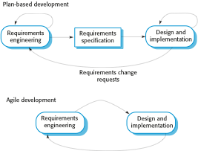
Plan-driven and agile specification

Slide 15
Agile – questions and challenges?
Documentation – it is still important in an Agile project.
If it is the only kind of communication in your project, it isn’t good
Real working code is more valuable than documents – less ambiguous
Documents – easy to leave something out, easy to misinterpret
Development plans – also important in an Agile project
the format of an Agile development schedule is a bit different from a conventional project plan.
Development plan includes “iterations”
Each iteration gives the team has a chance to incorporate what they learn, rather than just following a non-adaptive plan
Contracts – we expect to have contracts, but we need to talk with the customers as well.
Customer collaboration is one way to reduce development costs
Do you want to deliver “everything” the customer asked for in the original contract? No – if the customer no longer needs it, the extra code will increase maintenance costs
Always ask: Who needs this feature and how does it contribute to the value of the product?
Notes:
Documentation is not necessarily contrary to Agile values. You should think about keeping the process lightweight -- eliminating documentation that isn’t providing value. Scott Ambler has some interesting thoughts about what kinds of documentation make sense in an agile environment:
http://www.agilemodeling.com/essays/agileDocumentation.htm
Iterative development changes the way that development planning is done. In Agile methodologies such as Scrum, there is an organized way of doing adaptive planning, and there is a special vocabulary for describing both long-term and short-term plans
http://www.mountaingoatsoftware.com/product-backlog
http://www.mountaingoatsoftware.com/sprint-backlog
Alistair Cockburn has some good ideas about how to use Agile development techniques for situations such as fixed-price, fixed-scope contracts:
http://alistair.cockburn.us/Agile+contracts

Slide 16
Why is Agile Development important?
The world is a lot different today. A large feature set might only increase costs for the customer.
There is a constant introduction of new technology
New players enter the market,
New requirements are added
“Small is Beautiful”
If we are listening to the customer, we will reduce our chances of being “blindsided” by a smaller, more flexible competitor
Anything that helps reduce maintenance costs will contribute to the bottom line
Notes:
What is more important – delivering hundreds of features in a product, or delivering just the right set of features to meet your customer’s greatest needs? The answer is not obvious. But here is one consideration:
A product with a lot of features can be costly to deploy and costly to maintain. In today’s market, our customers are often looking to reduce their internal training and deployment costs – so it might be better to forget about delivering 92 features in a release… just think about the 16 features that are needed to implement the top 5 use cases.
If you develop a product with a small but well-coordinated feature set, you might be able to get it on the market faster – beat the competition.
Here are a few good articles on the benefits of keeping your code small:
“Keep It Small” by Jack Ganssle - http://www.ganssle.com/articles/keepsmall.htm
“Less Software” (from the online book Getting Real ) - http://gettingreal.37signals.com/ch10_Less_Software.php
“Small is Beautiful” by John Mashey (slides from an ACM talk in the late 1970s) -- http://www.usenix.org/events/bsdcon/mashey_small/

Slide 17
How hard is it to be Agile?
“Don’t do Agile, be Agile”
Just doing “development in iterations” isn’t enough
Agile Development is about:
Keeping the process lightweight
Making real progress in each iteration
Communicating – face-to-face when possible
Actively gathering customer input – early and often
Being willing to make minor changes to your process
Notes:
What does it mean to “Be Agile”?
“Agile is not a practice. It is a quality of the organization and its people to be adaptive, responsive, continually learning and evolving – to be agile, with the goal of competitive business success and rapid delivery of economically valuable products and knowledge.” (Craig Larman and Bas Vodde, Scaling Lean & Agile Development, Chapter 6.)
There are a number of Agile practices – you can “do iteration”, “do continuous integration”, “do automated testing”, “do regular customer demos”, and “do regular retrospectives”. These practices will help you be more adaptive and responsive.

Slide 18
Agile method applicability
Product development where a software company is developing a small or medium-sized product for sale.
Custom system development within an organization, where there is a clear commitment from the customer to become involved in the development process and where there are not a lot of external rules and regulations that affect the software.
Because of their focus on small, tightly-integrated teams, there are problems in scaling agile methods to large systems.

Slide 19
Problems with agile methods
It can be difficult to keep the interest of customers who are involved in the process.
Team members may be unsuited to the intense involvement that characterises agile methods.
Prioritising changes can be difficult where there are multiple stakeholders.
Maintaining simplicity requires extra work.
Contracts may be a problem as with other approaches to iterative development.

Slide 20
Agile methods and software maintenance
Most organizations spend more on maintaining existing software than they do on new software development. So, if agile methods are to be successful, they have to support maintenance as well as original development.
Two key issues:
Are systems that are developed using an agile approach maintainable, given the emphasis in the development process of minimizing formal documentation?
Can agile methods be used effectively for evolving a system in response to customer change requests?
Problems may arise if original development team cannot be maintained.

Slide 21
Agile Methods: Scrum

Slide 22
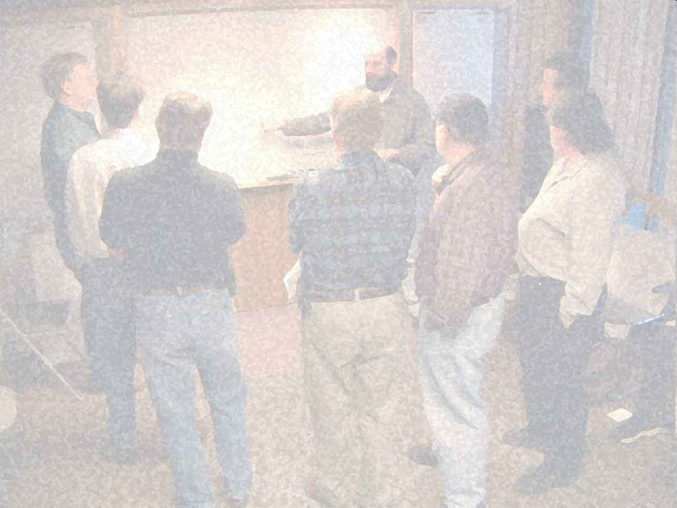

Agile methodologies
In this course, we will discuss the Scrum methodology
Scrum has been around since the early 1990s
The structure of Scrum is very simple (3 roles, 3 meetings)
Scrum is not as “extreme” as some other methodologies
What is a Scrum?
It is a meeting with attitude – good teamwork is necessary
a software scrum
a rugby scrum
Notes:
A “scrum” is “a meeting with an attitude”.
In rugby, the linemen have their arms linked together, and they are working cooperatively to move their opponents back so they can get the ball back to their teammates.
In a software scrum, it doesn’t look like the team is doing much, but they really are doing some hard work. They are getting a report on the status of every team member – each person is giving a short summary of the problems they are faced with on their tasks in the current iteration.

Slide 23
Let’s Scrum

Slide 24
Scrum overview
The Scrum presentation is short and simple:
Scrum iteration process
Product Backlog
Roles: Team Member, Product Owner, and Scrum Master
Project estimation and iteration estimation
Daily Scrum Meeting
Management
Retrospectives
Notes:
A good Scrum overview: Scrum Guide, a short (about 20-page) article by Ken Schwaber -- http://www.scrum.org/scrumguides
See also:
Mike Cohn’s Scrum introduction -- http://www.mountaingoatsoftware.com/scrum
Short video on Scrum roles -- http://www.youtube.com/watch?v=vmGMpME_phg
Notes on Scrum on the Alcatel-Lucent ACOS Be-Agile wiki: http://acos.alcatel-lucent.com/wiki/g/be-agile/Scrum

Slide 25
Scrum iteration process
Scrum is designed to organize the work of a single cross-functional team
The team will do software product development this way:
Iteration planning – create a plan for one iteration
Select next features or sub-features to deliver (choose from highest priority items), define and estimate tasks, negotiate scope of the delivered product
Iteration execution – implement the items in the plan
Fill in missing requirements, design, code, integrate/build, and test the modules needed in the plan
Deliver the results of the iteration – give a demo
Steps 1 – 3 will be executed many times – based on the Release Plan
Each cycle is a fixed-length timebox:
Always end each iteration on schedule, even if it isn’t complete
(Don’t say – “we can finish everything in this iteration in 2 more days”. Just deliver and run the next iteration planning meeting.)
The team learns to make good short-term estimates – so over time, most of the iterations will deliver as expected
Notes:
Scrum uses timeboxed iterations. This is important. Everyone on the team knows when the iteration will end – and this is useful information when the team members make estimates at the beginning of the iteration.

Slide 26
Scrum Elements
THREE Roles
Product Owner
Scrum Master
Team Member
THREE Meetings
Planning (Release & Sprint)
Daily Scrum
Sprint Review
THREE Lists
Product Backlog
Spring Backlog
Impediments List
For details, see Scrum Guide: http://www.scrum.org/scrumguides

Slide 27
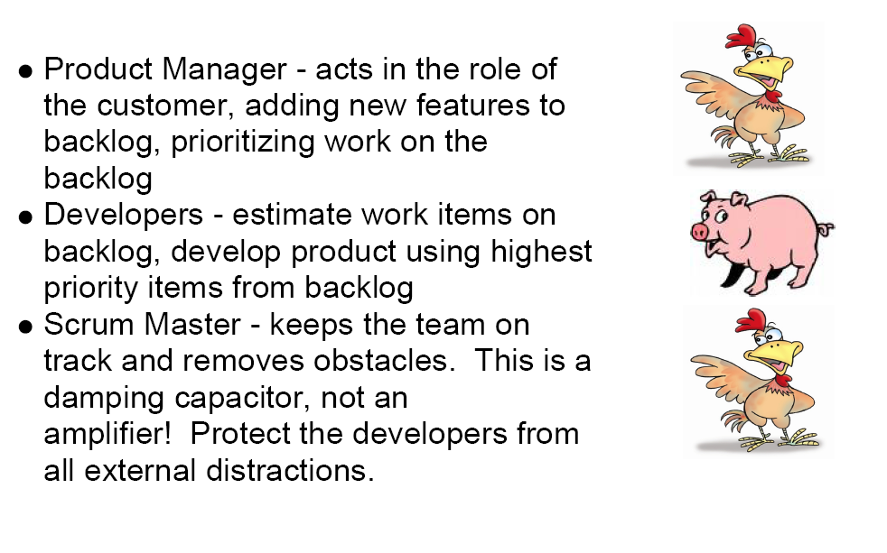
More on Scrum Introductopn
http://www.youtube.com/watch?v=vmGMpME_phg

Slide 28
Scrum iteration process
The Product Backlog is the set of all features and sub-features that you know you need to do to build the product
This is the “plan” for multiple iterations
The items in the Product Backlog is ordered by priority – value to the customer
you want to deliver some value to the customer in each iteration, so you put the most important things early
It is OK to add things to the Product Backlog at any time
Backlog item Prio Size
Subfeature 1 1 5
Subfeature 2 2 8
Subfeature 5 3 13
Subfeature 4 4 1
Subfeature 3 5 2
…
A Scrum iteration (called a Sprint) contains a list of tasks and work product outputs that will be done in a 4-week* timebox
At the beginning of the 4 weeks, each team member has a pretty good idea of what they will be working on
Management should not add new work product outputs to the Sprint – any new items should be added to the Product Backlog instead
If new work items are important enough, they will get done in the next 4 week iteration
* (30-day iteration in the original Scrum articles – most teams use a 2-week
to 6-week iteration)
Notes:
The Product Backlog is the list of “everything” – in priority order.
In a Sprint, the team will work on a very small subset of the Product Backlog. When planning the Sprint, the team will consider the business value they will be able to deliver at the end of the Sprint.
The reasons for the Product Backlog:
The team can start doing the “most valuable” parts of the system in early iterations – the system features that have the highest business value to the customer.
If some new “high-value features” are discovered later, they can be added to the Product Backlog – and they might actually push some other less valuable features out of the release. This is OK – assuming that your customers really want you to build the newly discovered features (instead of just blindly delivering the items in the original release plan).
The estimates in the Product Backlog help managers plan the release: they should try not to promise more than the team thinks they can deliver.
Even if there are problems delivering everything in the release plan, following the Product Backlog in each iteration will result in the team delivering the maximum customer value possible with the resources available.

Slide 29
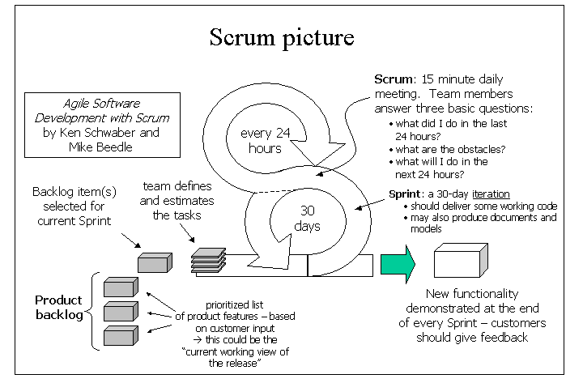
a 2 to 4 week iteration
2 to 4 weeks

Slide 30
Product Backlog
What does a Product Backlog look like?
It is a simple spreadsheet
All “Product Backlog Items (PBIs)” are in priority order
Some PBIs are the names of “customer features”
Could be a user screen, an interaction scenario or use case, a new report, a new algorithm
Much, much smaller than a telecom system feature
Some PBIs are internal tasks that contribute to the value of the product
Can a design document be a PBI? Maybe.
If it is a document that nobody reads, leave it out (because you are Agile)
Can an early GUI prototype be a PBI? Certainly.
Effort estimates – each PBI should have an “estimated effort” that is assigned by the team
Should managers do the estimation of Product Backlog Items? No, never.
Estimates must come from the team – and they should be realistic
Notes:
There are a number of commercial and open source tools that could be used to manage the Product Backlog. See http://acos.alcatel-lucent.com/wiki/g/be-agile/Tools%20for%20Agile for more information.

Slide 31
Project estimation and iteration estimation
The Product Backlog – managers and customers use it to set the working agenda of the development team
Managers and customers work with Product Owner to set the priority of each item
Development team estimates the size/effort for each item
Even if the managers and customers don’t like the estimates, they are not allowed to change them
Backlog item Prio Size
Subfeature 1 1 5
Subfeature 2 2 8
Subfeature 5 3 13
Subfeature 4 4 1
Subfeature 3 5 2
…
Within an iteration, the team divides the Product Backlog Items into individual tasks – the “task view” is only used within the iteration
Development team defines tasks and the estimated effort
The list of tasks is flexible – new items might be discovered during the iteration, some items might be combined or eliminated
Development team tracks all “tasks” on a Task Board
Development team tracks progress with a burndown chart
Notes:
The most common technique for doing estimates of the Product Backlog is to use an “artificial” estimation unit: Story Points. This often works better than trying to estimate the number of days of effort.
Estimation for a single Sprint – estimating in days or hours makes more sense here.

Slide 32



Roles on a Scrum team
Product Owner
Responsible for the ROI
Available for the Team during the whole product development period
Gets answers to all requirements questions
Talks with customers and understands their priorities
Keeps the Product Backlog current
Scrum Master
Scrum rules guardian
Coach the team
Removes impediments
Prevents outside interference during an iteration
Scrum Master is both a teacher and a referee
Notes:
32
For more information on how traditional project roles are changed when using Scrum, read Chapter 8 of Mike Cohn’s book Succeeding with Agile -- http://www.infoq.com/articles/cohn-chapter8
The Scrum Master is not the “manager of the team” – the team is actually “self-organizing”. But every team needs help staying organized, and every team needs help with obstacles and impediments.

Slide 33
Burndown chart
Tracking an iteration:
A burndown chart tracks the amount of estimated effort remaining in the current iteration
it should go down each day
but if you discover that something is missing, or you have mis-estimated a difficult task, it could go up
it’s OK: better to acknowledge reality early
Don’t make your estimates too pessimistic
you will get a burndown chart that gets to zero well before the end of the iteration
100
80
60
effort remaining
40
20
0
Burndown chart #1
time (days)
100
80
60
40
20
0
Burndown chart #2
Notes:
More information on burndown charts:
http://alistair.cockburn.us/Earned-value+and+burn+charts
What are the units in the burndown chart? Vertical axis is “person days”, horizontal axis is “days” – one point on the curve for each working day.
How to create the curve?? Each day, go to the Task Board. Each task should have an index card, with the remaining estimated effort to complete the task. Just add up the numbers.
At the end of the iteration, all of the cards should be “completed” – zero time left to complete.
Why could the curve go higher? You might have missed a task in the initial iteration planning, or you might discover as you start a task that it will take longer than the original estimate.
If the burndown chart isn’t going down fast enough… the team has to take action to improve things – usually immediately. Slide 19 listed the top three recovery actions:
Get more resources
Try to reduce scope (negotiate with the Product Owner)
Revisit the product’s software architecture

Slide 34
Daily Scrum Meeting
The Scrum Team has two kinds of “once-per-iteration” meetings:
An Iteration Planning meeting at the beginning of each Sprint
A Sprint Review meeting at the end of each Sprint
In addition, the Scrum Team has one daily meeting: the Daily Scrum
Daily Scrum is 15 minutes – no longer
Everyone is supposed to speak:
“This is what I did yesterday.”
“Here is what I am planning to do today.”
“These are the obstacles in my way.”
No problem solving in the meeting – everything is taken offline later.
What is the purpose of the Daily Scrum? To make sure that problems and obstacles are visible to the team
Obstacles are valuable input for managers
Notes:
The Daily Scrum Meeting (also known as the “standup meeting”) is a daily ritual. It isn’t really a traditional status meeting. Its main function: to make sure that if someone in the team is stuck for one day, the rest of the team will help get them unstuck immediately.

Slide 35
Retrospectives
One important idea in Agile Development: take time to reflect and learn
Iteration is good, because you have a natural breakpoint to apply some of what you have learned
In Scrum (and many other Agile methodologies), the team runs a Retrospective meeting at the end of each iteration
A Retrospective is like a post-mortem, but it isn’t dead yet
An end-of-iteration retrospective meeting takes an hour or two
The end-of-iteration Retrospective meeting is a chance to learn what worked well, what should be changed
don’t use a Retrospective to blame team members or managers for all of the problems – focus on fixing the process
Notes:
A popular book on end-of-iteration retrospectives: Agile Retrospectives by Esther Derby and Diana Larsen.
The classic book on Retrospectives for software projects: Project Retrospectives by Norm Kerth.

Slide 36
Retrospectives
The Retrospectives Prime Directive:
Regardless of what we discover, we understand and truly believe that everyone did the best job they could, given what they knew at the time, their skills and abilities, the resources available, and the situation at hand.
(From Norm Kerth’s book on Project Retrospectives See also http://www.retrospectives.com )
Why this rule? The goal of a retrospective is to improve the process, not to assign blame for the problems
Notes:
Retrospectives should never be used as part of the “performance management” system for a company – you want the retrospective participants to be free to focus on learning the lessons of the past to make things work better in the future. “Blame the process, not the person.”
See the following InfoQ article for more information on the application of the Retrospectives Prime Directive:
http://www.infoq.com/articles/retrospective-prime-directive
Norm Kerth’s book on Project Retrospectives or Esther Derby and Diana Larsen’s book on Agile Retrospectives.

Slide 37
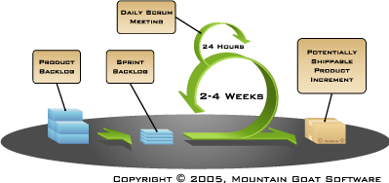
Scrum summary
Scrum is a “team-oriented” Agile methodology
Short timeboxed iterations
Each iteration produces some real software that has value to the customer
Each iteration has
iteration planning
development work
iteration review
All estimation is done by the team
Within a Sprint, the progress is tracked using a burndown chart
Product Owner determines the priorities in the Product Backlog (list of things to build)
Scrum Master helps enforce the rules of Scrum
There is a 15-minute daily meeting to report what was done and identify obstacles
100
80
60
effort remaining
40
20
0
Burndown chart #1
time (days)

Slide 38
Scrum Adoption
This high-level presentation of Scrum has focused on the simple Scrum structure and rules.
But running Scrum and getting the core benefits from it is HARD
Cross-functionality and self-organization
Transparency, Inspect and Adapt
Continuous improvement
38 | Agile Intro | June 2010
Notes:
38

Slide 39
More on Scrum
There are many more things to learn about Scrum. We will touch on some of those in the discussion:
How to run big projects (more than one Scrum team)
Can managers interfere with a Sprint in progress?
Fixed schedule and fixed cost contracts
Part-time team members (specialists)
A single Scrum team with members in multiple locations
Architecture
CMMI / ISO9000 standards
Some references:
Scrum Guide: http://www.scrum.org/scrumguides
Scrum Primer: http://scrumtraininginstitute.com/home/stream_download/scrumprimer
Craig Larman’s books on Safari: http://techbus.safaribooksonline.com/9780321685117
39 | Agile Intro | June 2010
Notes:
39
Big projects – look for information on the “Scrum of Scrums” approach.
Managers can “cancel a Sprint” – a bit extreme, but sometimes necessary when the goals of a project change. This “abnormal early termination process” is mentioned in many of the Scrum books.
Fixed schedule and fixed contract is never easy, but an experienced Scrum team can do a pretty good job – because they have some practice at doing short term estimation. It is still necessary to add some extra “slack” to the estimates to handle unexpected variation from the estimates.
Part-time specialists are almost inevitable – there are specialists in our company who are in demand for their skills, so it may be necessary to adapt Scrum to use them in a part-time capacity. Also, some part-time workers might be needed in the transition to Scrum – such as testers.
Multiple-location teams are possible but difficult. You need to think about using several kinds of communication technology to get the effect of face-to-face.
Scrum doesn’t directly address architecture issues – but architecture has been discussed by many industry experts.
CMMI, ISO9000, and TL9000 certification is possible, even for a team using Scrum. There will be some extra “documentation” that needs to be created and maintained to meet certification requirements.

Slide 40
Agile Methods: Extreme programming

Slide 41
Extreme programming
Perhaps the best-known and most widely used agile method.
Extreme Programming (XP) takes an ‘extreme’ approach to iterative development.
New versions may be built several times per day;
Increments are delivered to customers every 2 weeks;
All tests must be run for every build and the build is only accepted if tests run successfully.

Slide 42
XP and agile principles
Incremental development is supported through small, frequent system releases.
Customer involvement means full-time customer engagement with the team.
People not process through pair programming, collective ownership and a process that avoids long working hours.
Change supported through regular system releases.
Maintaining simplicity through constant refactoring of code.

Slide 43
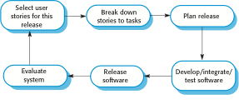
The extreme programming release cycle

Slide 44
Extreme programming practices (a)
Principle or practice | Description
Incremental planning | Requirements are recorded on story cards and the stories to be included in a release are determined by the time available and their relative priority. The developers break these stories into development ‘Tasks’. See Figures 3.5 and 3.6.
Small releases | The minimal useful set of functionality that provides business value is developed first. Releases of the system are frequent and incrementally add functionality to the first release.
Simple design | Enough design is carried out to meet the current requirements and no more.
Test-first development | An automated unit test framework is used to write tests for a new piece of functionality before that functionality itself is implemented.
Refactoring | All developers are expected to refactor the code continuously as soon as possible code improvements are found. This keeps the code simple and maintainable.

Slide 45
Extreme programming practices (b)
Pair programming | Developers work in pairs, checking each other’s work and providing the support to always do a good job.
Collective ownership | The pairs of developers work on all areas of the system, so that no islands of expertise develop and all the developers take responsibility for all of the code. Anyone can change anything.
Continuous integration | As soon as the work on a task is complete, it is integrated into the whole system. After any such integration, all the unit tests in the system must pass.
Sustainable pace | Large amounts of overtime are not considered acceptable as the net effect is often to reduce code quality and medium term productivity
On-site customer | A representative of the end-user of the system (the customer) should be available full time for the use of the XP team. In an extreme programming process, the customer is a member of the development team and is responsible for bringing system requirements to the team for implementation.

Slide 46
Requirements scenarios
In XP, a customer or user is part of the XP team and is responsible for making decisions on requirements.
User requirements are expressed as scenarios or user stories.
These are written on cards and the development team break them down into implementation tasks. These tasks are the basis of schedule and cost estimates.
The customer chooses the stories for inclusion in the next release based on their priorities and the schedule estimates.

Slide 47
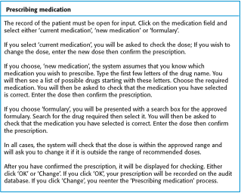
A ‘prescribing medication’ story

Slide 48
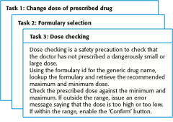
Examples of task cards for prescribing medication

Slide 49
XP and change
Conventional wisdom in software engineering is to design for change. It is worth spending time and effort anticipating changes as this reduces costs later in the life cycle.
XP, however, maintains that this is not worthwhile as changes cannot be reliably anticipated.
Rather, it proposes constant code improvement (refactoring) to make changes easier when they have to be implemented.

Slide 50
Testing in XP
Testing is central to XP and XP has developed an approach where the program is tested after every change has been made.
XP testing features:
Test-first development.
Incremental test development from scenarios.
User involvement in test development and validation.
Automated test harnesses are used to run all component tests each time that a new release is built.

Slide 51
Test-first development
Writing tests before code clarifies the requirements to be implemented.
Tests are written as programs rather than data so that they can be executed automatically. The test includes a check that it has executed correctly.
Usually relies on a testing framework such as JUnit.
JUnit is a Regression Testing Framework used by developers to implement unit testing in Java, and accelerate programming speed and increase the quality of code.
All previous and new tests are run automatically when new functionality is added, thus checking that the new functionality has not introduced errors.

Slide 52
Customer involvement
The role of the customer in the testing process is to help develop acceptance tests for the stories that are to be implemented in the next release of the system.
The customer who is part of the team writes tests as development proceeds. All new code is therefore validated to ensure that it is what the customer needs.
However, people adopting the customer role have limited time available and so cannot work full-time with the development team. They may feel that providing the requirements was enough of a contribution and so may be reluctant to get involved in the testing process.

Slide 53
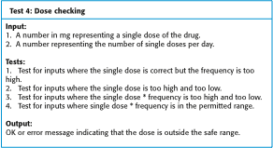
Test case description for dose checking

Slide 54
Test automation
Test automation means that tests are written as executable components before the task is implemented
These testing components should be stand-alone, should simulate the submission of input to be tested and should check that the result meets the output specification. An automated test framework (e.g. Junit) is a system that makes it easy to write executable tests and submit a set of tests for execution.
As testing is automated, there is always a set of tests that can be quickly and easily executed
Whenever any functionality is added to the system, the tests can be run and problems that the new code has introduced can be caught immediately.

Slide 55
XP testing difficulties
Programmers prefer programming to testing and sometimes they take short cuts when writing tests. For example, they may write incomplete tests that do not check for all possible exceptions that may occur.
Some tests can be very difficult to write incrementally. For example, in a complex user interface, it is often difficult to write unit tests for the code that implements the ‘display logic’ and workflow between screens.
It difficult to judge the completeness of a set of tests. Although you may have a lot of system tests, your test set may not provide complete coverage.

Slide 56
Pair programming
In XP, programmers work in pairs, sitting together to develop code.
This helps develop common ownership of code and spreads knowledge across the team.
It serves as an informal review process as each line of code is looked at by more than 1 person.
It encourages refactoring as the whole team can benefit from this.
Measurements suggest that development productivity with pair programming is similar to that of two people working independently.

Slide 57
Pair programming
In pair programming, programmers sit together at the same workstation to develop the software.
Pairs are created dynamically so that all team members work with each other during the development process.
The sharing of knowledge that happens during pair programming is very important as it reduces the overall risks to a project when team members leave.
Pair programming is not necessarily inefficient and there is evidence that a pair working together is more efficient than 2 programmers working separately.

Slide 58
Key points
Agile methods are incremental development methods that focus on rapid development, frequent releases of the software, reducing process overheads and producing high-quality code. They involve the customer directly in the development process.
The decision on whether to use an agile or a plan-driven approach to development should depend on the type of software being developed, the capabilities of the development team and the culture of the company developing the system.
Extreme programming is a well-known agile method that integrates a range of good programming practices such as frequent releases of the software, continuous software improvement and customer participation in the development team.

Slide 59
Key points
A particular strength of extreme programming is the development of automated tests before a program feature is created. All tests must successfully execute when an increment is integrated into a system.
The Scrum method is an agile method that provides a project management framework. It is centred round a set of sprints, which are fixed time periods when a system increment is developed.
Scaling agile methods for large systems is difficult. Large systems need up-front design and some documentation.

Slide 60
Summary
Agile Development – it is a different way of organizing product development
Emphasizes iterative development with small cross-functional teams instead of waterfall development in separate silos
At the end of each iteration, there is some functionality that is “done”
Better communication, faster feedback
Why do we need to be Agile?
Products are different from 20 years ago
Customers are in a changing environment – and our processes need to be working at the same pace
Working in short cycles reduces time to market and time to quality
There are many ways to be Agile
Scrum is the most popular Agile approach
Scrum promotes some good Agile practices
Small cross-functional teams, short timeboxed iterations, adaptive planning, single product backlog, frequent integration, test automation

Slide 61
The Nokia Test and the Key Agile Concepts
Iterations
Expanding scope of Done to deployment
Up-front specifications w/User Stories
Product owner who plans
Up-front Product Backlog
Up-front estimates
Business-oriented burndown chart
Team disruption

Slide 62



